Slide 1
615 Final Presentation ——Palau Island
Xiaohan Shi

Slide 2
General Description
Palau is located in the Micronesia region of the Western Pacific Ocean.
The total area of Palau is about 459 square kilometers (about 177 square miles), which makes it one of the smallest countries in the world.

Slide 3
Key Facts of Palau
Government
Palau is a constitutional presidential republic with a bicameral legislature, the Olbiil Era Kelulau, and an independent judiciary. Its capital is Engelmade.
Economy
Palau’s economy relies on tourism, subsistence agriculture, and fishing.
Nature Environment
For a tiny archipelago with only a 328.14 square km landmass, Palau has an intriguing biodiversity of its own (Home - Pristine, n.d.).
Around 75% of Palau’s volcanic, coral atoll, and limestone islands are covered in native forests and mangroves. These forests, the most biodiverse in Micronesia, host over 1,400 plant species, including 194 endemic varieties such as 23 unique orchid species.

Slide 4
Key Facts of Palau
Culture
Matrilineal: The matrilineal traditions of Palauan culture deeply influence the social structure.
Respect for Nature: Traditional beliefs emphasize the harmonious coexistence of man and nature, a concept that is not only reflected in ancient practices, but is also compatible with modern concepts of environmental protection.
Oral Tradition: Through the telling of myths, legends and historical stories, Palauans maintain their cultural memory and transmit the values and identity of their communities.
Traditional Navigation: As a maritime people, Palauans are known for their excellent traditional navigation skills. They navigate the vast Pacific Ocean using the stars, winds, and nature to guide them, and this seafaring tradition, which is closely tied to the sea, is embedded in their cultural DNA.
Climate
Palau has a tropical rainforest climate with an average annual temperature of about 28°C. Rainfall is abundant throughout the year, with 3,800 millimeters per year. The average humidity is 82% and although rainfall is more frequent from June to October, sunshine is still abundant.

Slide 5
Key Facts of Palau
Culture
Matrilineal: The matrilineal traditions of Palauan culture deeply influence the social structure.
Respect for Nature: Traditional beliefs emphasize the harmonious coexistence of man and nature, a concept that is not only reflected in ancient practices, but is also compatible with modern concepts of environmental protection.
Oral Tradition: Through the telling of myths, legends and historical stories, Palauans maintain their cultural memory and transmit the values and identity of their communities.
Traditional Navigation: As a maritime people, Palauans are known for their excellent traditional navigation skills. They navigate the vast Pacific Ocean using the stars, winds, and nature to guide them, and this seafaring tradition, which is closely tied to the sea, is embedded in their cultural DNA.
Climate
Palau has a tropical rainforest climate with an average annual temperature of about 28°C. Rainfall is abundant throughout the year, with 3,800 millimeters per year. The average humidity is 82% and although rainfall is more frequent from June to October, sunshine is still abundant.

Slide 6
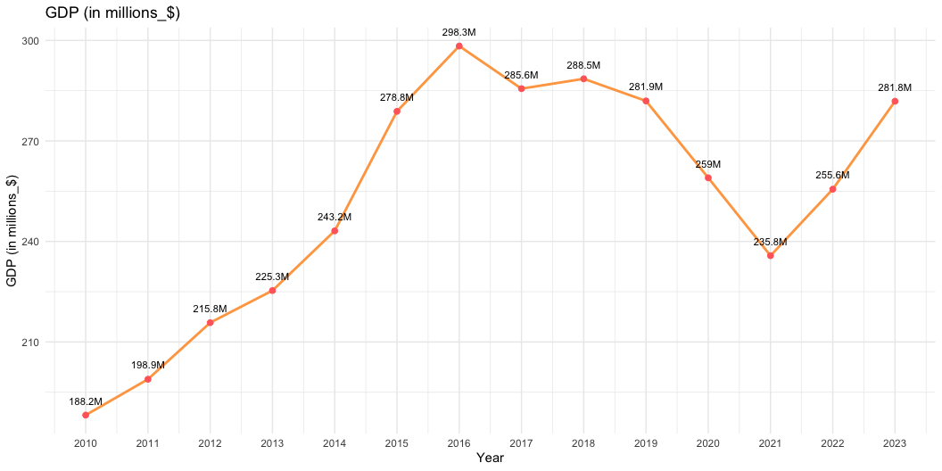
Key Demographics
GDP

Slide 7
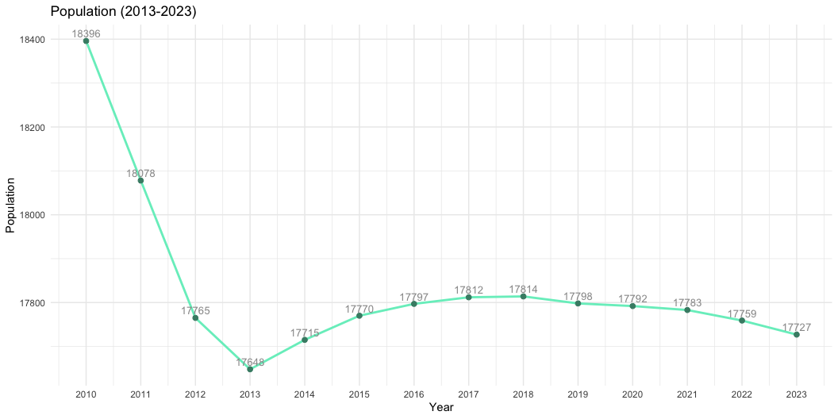
Key Demographics
Population

Slide 8
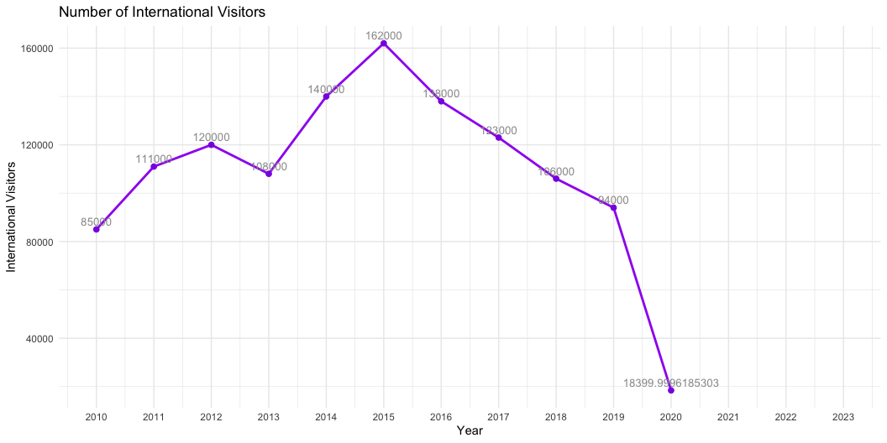
Key Demographics
Visitors

Slide 9
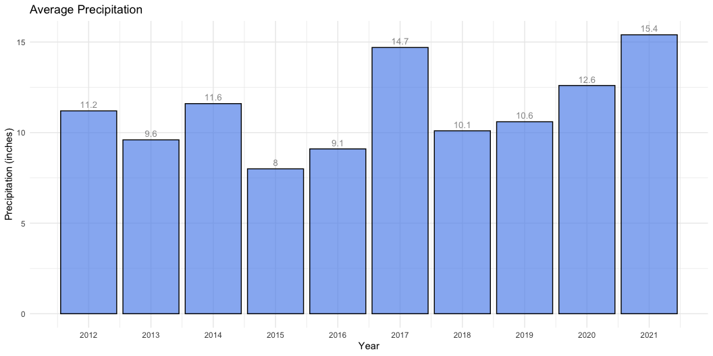
Key Demographics
Weather

Slide 10
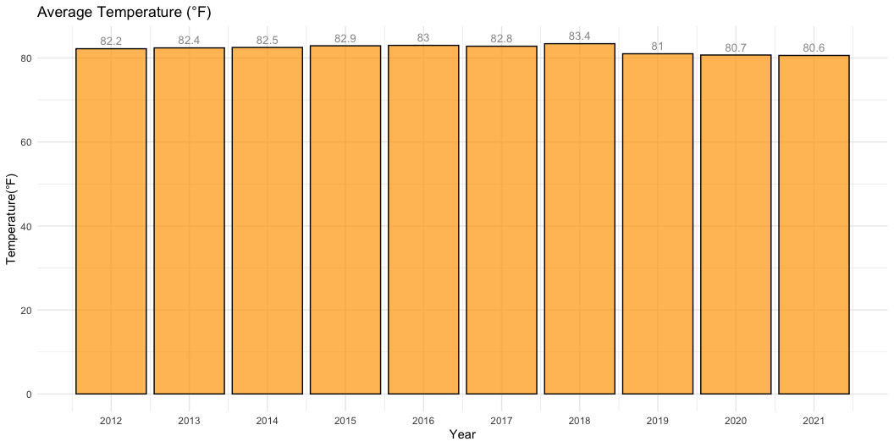
Weather

Slide 11
Comparative Analysis
Fiji
Why choose Fiji:
Fiji's geographic proximity to Palau, similar reliance on tourism, and shared environmental and economic challenges. Additionally, both countries are known for their marine biodiversity.

Slide 12
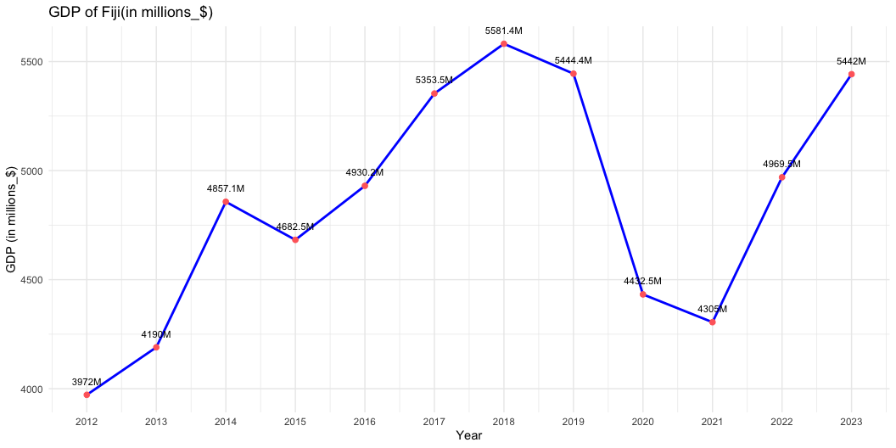
Comparative Analysis: Fiji

Slide 13
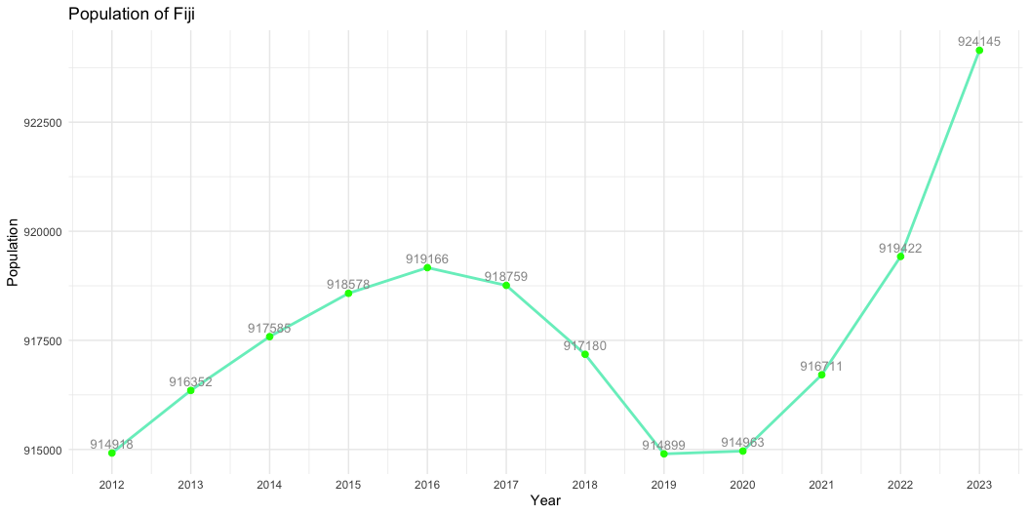

Slide 14
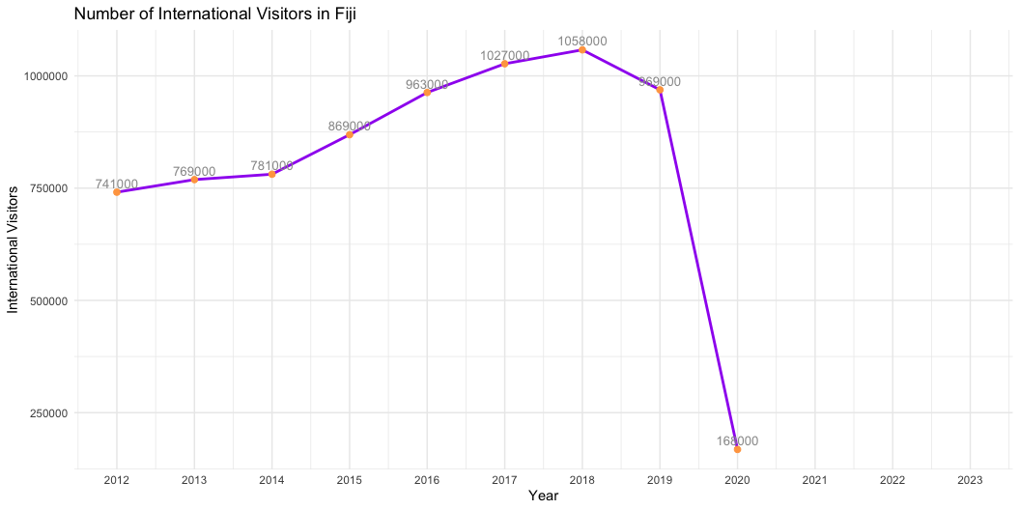

Slide 15
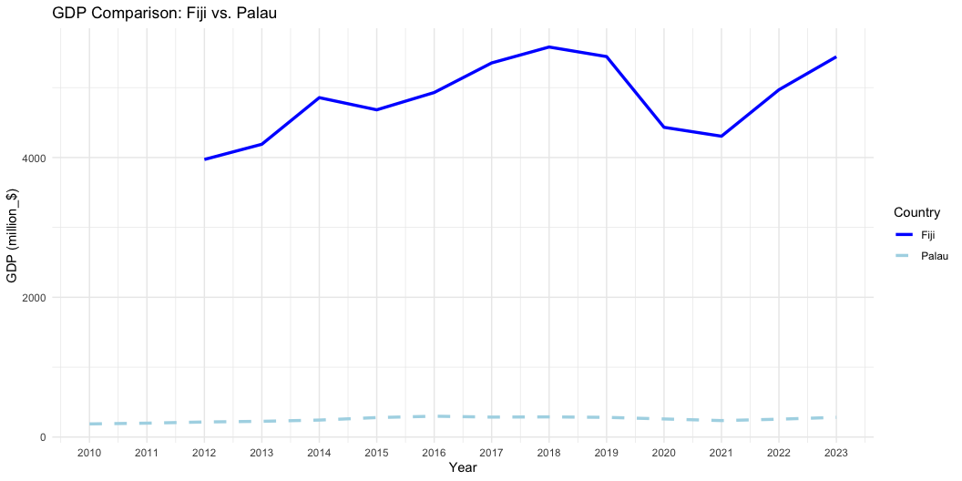
Comparative Analysis

Slide 16
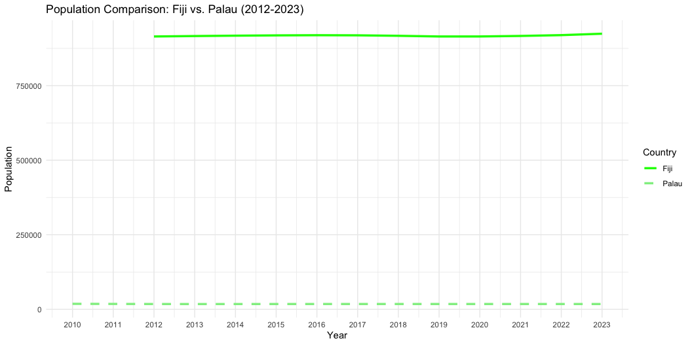

Slide 17
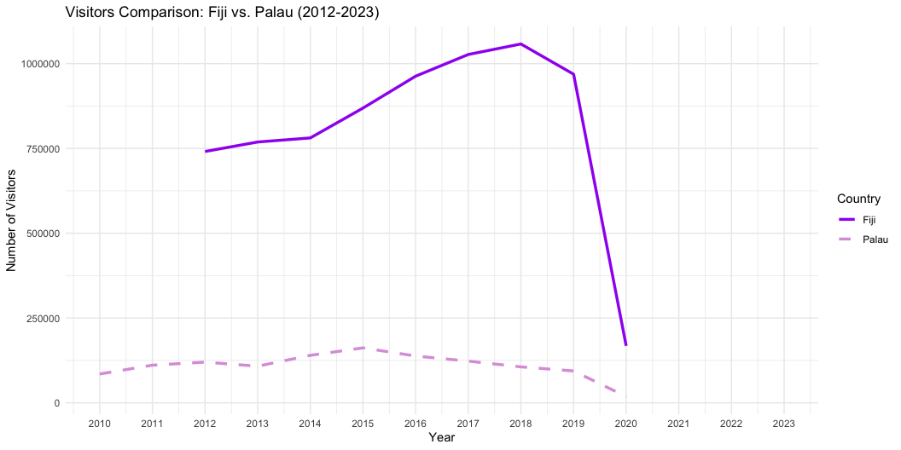

Slide 18
SWOT Analysis
Strengths
Unique natural environment: Palau offers unrivalled pristine natural beauty, as well as world-class diving and snorkeling sites such as the German Channel and wreck sites.
Conservation pioneers: Palau has demonstrated leadership in environmental protection by pioneering Marine protected areas around the world, such as the Palau National Marine Sanctuary.
Weaknesses
Land and resource constraints: Palau is small in size, lacks exploitable resources, and receives fewer tourists than other popular islands such as Fiji.
Economy highly dependent on tourism: other industries such as agriculture and fishing are small, limiting the potential for economic diversification.

Slide 19
SWOT Analysis
Opportunities
Special-interest tourism market: pristine natural environments and location can attract tourists who are ecologically friendly and want to be away from crowd.
Unique culture: Palau is rich in traditional culture, such as local handicrafts, traditional villages and legends, which can serve as an important resource for attracting tourists.
International cooperation and investment
Threats
Climate change: Palau‘s special Unique geographical features makes it vulnerable to weather hazards caused by climate change, such as extreme high tides, coastal erosion and seal-level rise.
Global economic fluctuations: As Palau is a highly tourism-dependent economy, a global economic downturn or crisis can directly affect visitor numbers and revenues. The impact of the global pandemic on Palau’s tourism and GDP in 2019-2021 is one example.

Slide 20
References
About Palau - Office of the Special Prosecutor | Republic of Palau. (2019, June 3). Office of the Special Prosecutor | Republic of Palau. https://www.palauosp.org/about-palau/
Climate Statistics – PalauGov.pw. (n.d.). PalauGov.pw. https://www.palaugov.pw/executive-branch/ministries/finance/budgetandplanning/climate-statistics/
Home - Pristine. (n.d.). https://pristineparadisepalau.com/
Palau | Culture, History, & People. (2019). In Encyclopædia Britannica. https://www.britannica.com/place/Palau
Wikipedia Contributors. (2024, November 21). Palau. Wikipedia; Wikimedia Foundation. https://en.wikipedia.org/wiki/Palau
World Bank Climate Change Knowledge Portal. (n.d.). Climateknowledgeportal.worldbank.org. https://climateknowledgeportal.worldbank.org/country/palau/vulnerability
World Bank. (2024). World Development Indicators. R package WDI. Retrieved from https://data.worldbank.org

